Slide 1

The Role of Property Tax in Municipal Budget
Michal Radvan
Eva Tomášková

Slide 2

Background and Research Hypothesis
many Czech acts delegate tasks and duties to municipalities
municipalities need to find sufficient funding
several local taxes sensu lato in the Czech Republic: the immovable property tax and eight local charges
The role of the property tax is negligible, and municipalities must rely on sources of funding other than local taxes to meet their statutory obligations.

Slide 3
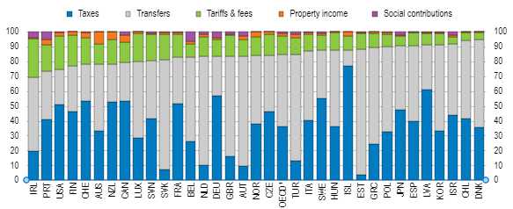
Importance of Property Tax for Municipal Budgets
Revenues of the territorial self-governing units by type (% of total revenues, data for 2016, unweighted average),
Source: OECD

Slide 4
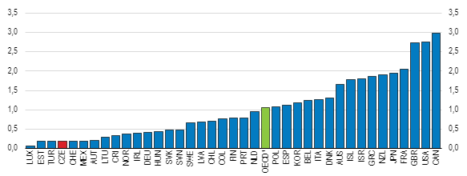
Recurrent taxes on immovable property, % of GDP
1. Unweighted average, 2021 or latest available year
Source: OECD Revenue Statistics

Slide 5
Importance of Immovable Property Tax for Municipal Budgets
Municipalities received a revenue of CZK 85.8 billion from shared taxes.
The share of immovable property tax in total tax revenues was only 3% in 2022 (other tax revenue and fees was over 60 % of total income).
Although municipalities had the opportunity to increase the immovable property tax coefficient and thus its total revenue, this option was not used much by municipalities.
Between 2013 and 2022, the average annual growth rate of immovable property tax was 2%.

Slide 6

Possibilities of Czech Municipalities to Influence Property Tax
two taxes on immovable property: the land tax and the tax on buildings
the unit/area-based system is used
administered by the central State tax offices
municipalities can adopt local bylaws
  to exempt immovable property affected by natural disasters, certain agricultural land (not gardens), and immovable property in special industrial zones
  to change coefficients influencing the tax rate (i.e., the location rent, the municipal coefficient) or the tax itself (i.e., the local coefficient)

Slide 7
Recent Development in Property Tax Regulation
good things (such as the introduction of the inflation coefficient, amendments in coefficients, regulation of correction components, reducing the excessive tax burden on hard-to-use land, etc.)
the draft bill aimed to introduce the state part and the local part of the immovable property tax
  new state part meant a 100% increase in the property tax, while the entire increase was to benefit the state budget
  a purely local tax was to become a shared tax
  property tax is administered by state tax offices, the abolition of the tax on acquisition of immovable property in 2020 should be compensated with the state part of the property tax
state portion of the immovable property tax was not introduced
changes in the percentage of redistributed shared taxes (VAT, PIT, CIT) to the benefit of the state budget and to the detriment of municipal budgets

Slide 8
Shared taxes
Until 2023, VAT, corporate income tax revenues and individual personal income taxes were distributed as follows:
  9.78% for the region budget;
  25.84% for the municipal budget;
  64.38% for the state budget.
In 2024, VAT, corporate income tax revenues and individual personal income taxes are distributed as follows:
  9.76% for the region budget;
  24.92% for the municipal budget;
  65.32% for the state budget.

Slide 9
Discussion - changes in the percentage of redistributed shared taxes
Income of municipalities from shared taxes in 2021 and 2022 and quantification of the amount of the change in the budgetary allocation of taxes
Source: Own processing according to documents from the Ministry of Finance of the Czech Republic (no data for 2023 at the moment)

Slide 10
Discussion – impacts of new changes
The immovable property tax revenue will become a more significant income for municipalities from 2024
The municipality does not still have access to information about which property owners paid this tax even after this change
It is associated with significant administration
The dynamics of immovable property tax revenue and shared tax revenue are different.
  Between 2013 and 2022, immovable property tax revenue increased by 21%, while shared tax revenue increased by 92%.
Sustainability of municipal budgets.
  Municipalities are trying to manage a long-term balanced budget.
  In 2022, 50.6 % of municipalities reported debt.
  It will be challenges for municipalities.

Slide 11
Immovable Property Tax Regulation de Lege Ferenda
the recurrent property tax must remain exclusively local tax.
problem of low revenue could be resolved by adopting an ad valorem tax base
  no political will to increase the immovable property tax revenue
  no real incentive to implement an ad valorem system
  expensive to establish, administratively demanding, and time-consuming
retain the unit system (area) tax base
one maximum tax rate and municipalities should have the right to introduce their own specific tax rates below that level
  6,258 municipalities in the Czech Republic
  another rate (standard rate) in the legislation
it is reasonable to retain state tax offices as tax administrators

Slide 12
Conclusions I
why property owners should pay tax on property they have acquired from previously taxed income
property owners benefit from the services provided by the municipalities and cities
services increase not only the quality of life but also the value of the property
fundamental requirements for the tax to be suitably designed, sufficiently general and comprehensible, simple to calculate, with minimal administration and collection costs, and, last but not least, to take account of the specificities of each municipality

Slide 13
Conclusion II
hypothesis that the role of the immovable property tax is negligible and municipalities must rely on sources of funding other than local taxes to meet their statutory obligations was confirmed
Although the state part of the property tax has not been introduced, with regard to the reduction of the municipalities' share of shared taxes, the winner of these changes is the state
municipalities will have to find another source of revenue, including a possible increase in the property tax
it is to be expected that municipal investment plans will be slowed or suspended

Slide 14


