Slide 1
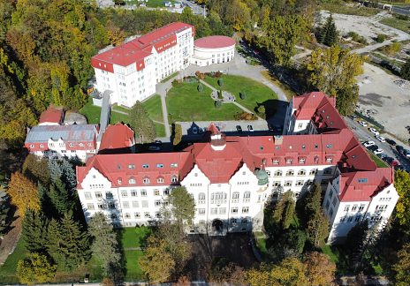
Emerging trends in Financial Sustainability of slovak Local Governments
Mária Murray Svidroňová
Matej Bel University in Banská Bystrica
Faculty of Economics
Department of Public Economics and Regional Development

Slide 2
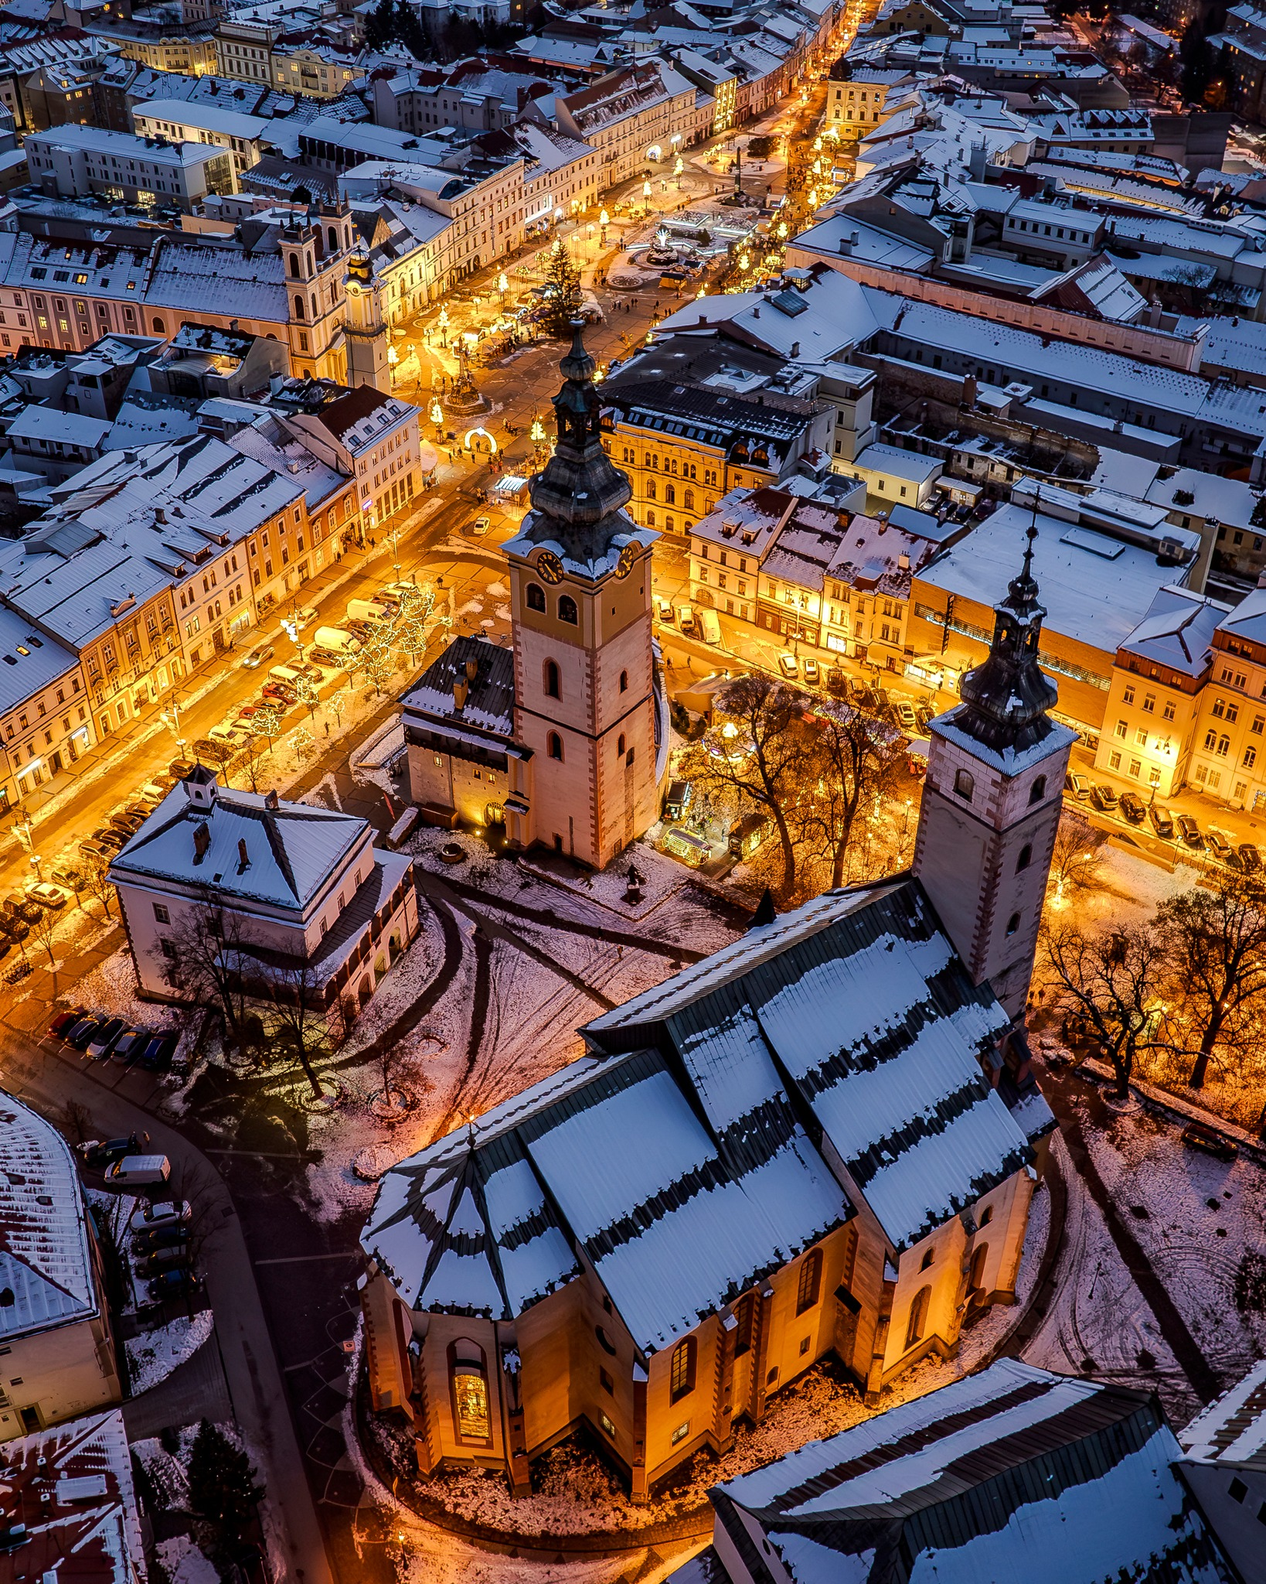
Content
Financial health
www.hospodarenieobci.sk
Participatory budgeting
Determinants of sustainability
Current research
VEGA no. 1/0449/23 “Municipality development in Slovakia based on consumption opportunities in a post-crises environment”
of participatory budgeting:
Slovak perspective

Slide 3
Financial health
The main goal of this initiative is to increase the pressure to improve the financial health municipalities and regions.
Collection and publication of data on the financial health of all 2928 municipalities and 8 higher territorial units (regions).
Thanks to the fact that citizens and the media will get more information about the management of their municipality compared to other municipalities, they will be able to more effectively demand the responsible behavior of their mayor or governor.

Slide 4
Participatory budgeting (PB)
A very important factor is the financial capacity of individual municipalities, which is often beyond their direct control (Goldfrank, 2006).
When resources for PB are relatively small, this significantly constrains the process (Boulding and Wampler, 2010; McNulty, 2012; Pape and Lerner, 2016). These options are influenced by municipal revenue generation (e.g., in the form of national tax sharing) and mandatory expenditures.
Devolution of responsibility from the central level to local governments without adequate funding, which is typical for Slovakia may also result in a lack of funding for PB.
Főlscher (2007) reports that local governments' expenditure obligations often did not match their revenue capacity, which limited the uptake of PB in Central and Eastern Europe countries.

Slide 5
Participatory budgeting - research
The research sample consists of all 59 local governments that have implemented PB, which is still on-going, supplemented by other local governments that have the status of an urban municipality in Slovakia, a total of 155 municipalities.
H1: The better the financial situation of local governments, the higher sustainability of PB.
There is a weak inverse relationship (- 0.116) between the level of indebtedness in 2020 and whether municipalities have PB in place in 2021, i.e. municipalities are more likely to have PB in place if they have a lower level of indebtedness. If we look at the correlation between whether a municipality had a participatory budget in place and the level of indebtedness in more distant years, we see that the correlation increases slightly. The introduction of PB in 2021 correlates somewhat more strongly with the level of indebtedness in 2019 (rs = -0.156) and 2018 (rs = -0.184). In other words, municipalities that have had better financial health over the longer term are more likely to introduce PB.
Our results show that local governments are more likely to adopt or implement PB if they are in a better financial position. While this is a relatively common approach in CEE (Klun and Benčina, 2021; Soukop et al., 2021), in Germany, for example, the behaviour of local governments is different. Apostolou and Eckardt (2022), based on exploratory cluster analysis and confirmatory mean analysis, show that the adoption of the PB process is more likely in municipalities with financial problems.
Spearman's rho |  | Debt ratio 2020 | Debt ratio 2019 | Debt ratio 2018 | Debt ratio 2017 | Debt ratio 2016
PB_2021 | Correlation Coefficient | -0.116 | -0.156 | -.184* | -.165* | -0.156
 | Sig. (2-tailed) | 0.150 | 0.053 | 0.022 | 0.040 | 0.053
PB_2020 | Correlation Coefficient | -0.087 | -0.119 | -0.142 | -0.123 | -0.120
 | Sig. (2-tailed) | 0.280 | 0.141 | 0.079 | 0.127 | 0.135
PB_2019 | Correlation Coefficient | -0.114 | -.165* | -0.135 | -0.110 | -0.107
 | Sig. (2-tailed) | 0.158 | 0.040 | 0.094 | 0.173 | 0.186
PB_2018 | Correlation Coefficient | -0.018 | -0.070 | -0.032 | -0.029 | -0.008
 | Sig. (2-tailed) | 0.823 | 0.390 | 0.690 | 0.717 | 0.925
PB_2017 | Correlation Coefficient | -0.022 | -0.066 | -0.040 | -0.039 | -0.020
 | Sig. (2-tailed) | 0.787 | 0.415 | 0.621 | 0.628 | 0.804
PB_2016 | Correlation Coefficient | -0.029 | -0.053 | 0.005 | -0.001 | 0.010
 | Sig. (2-tailed) | 0.724 | 0.516 | 0.953 | 0.986 | 0.906
PB_2015 | Correlation Coefficient | -0.054 | -0.074 | -0.046 | -0.027 | -0.005
 | Sig. (2-tailed) | 0.502 | 0.358 | 0.568 | 0.735 | 0.952
PB_2014 | Correlation Coefficient | -0.113 | -0.115 | -0.084 | -0.068 | -0.047
 | Sig. (2-tailed) | 0.161 | 0.154 | 0.300 | 0.401 | 0.563
N |  | 155 | 155 | 155 | 155 | 155

Slide 6
Current research – VEGA no. 1/0449/23
This research aims to determine the opportunities of lesser municipalities to larger metropolitan areas in order to draw attention to potential in areas that are out of favor.
Large metropolitan areas are seen as bastions of opportunity for firms as they provide innovation clusters that eventually create a spill-over effect to other sectors. For individuals, this dynamism is seen as being advantageous by providing greater financial possibilities when compared to smaller, less robust municipalities.
These income differentials between commuter zones (CZ) are well documented, yet less is known about the living standard of municipalities in terms of individual purchasing power – the level of consumption that individuals can afford.
This research will focus on consumption opportunities and quality of life of individuals in Slovakia, by CZ and the ability of local governments to develop and to satisfy citizens´ needs.

Slide 7
The urban/rural divide based on a geo-economic perspective
Cities can be divided into 3 categories:
primate cities (the largest/most important city in a country (Jefferson, 1939);
region cities or regional primate cities (the most important city of a region) (Tasan-Kok, 2004); and
smaller agglomerated areas (Arshad et al., 2018) - these areas constitute the commuter zones (CZs).
The assumed advantages of concentrated agglomeration are well known especially from the point of view of companies (like-minded businesses stimulating innovation in a specific field, intellectual spill over creating new businesses, and a shift from manufacturing to service, etc.).
This argument ignores:
advantages of the internet - especially after the COVID-19 pandemic, which made it possible to operate in the so-called home office mode, working from home became a common thing and commuting to work changed to 3-4 days a week from the original 5 (still a little is known about the domestic migration in terms of work/home space relationships after the pandemic);
and, at the same time, discounts the land-rent premium that must be paid in large urban settings.

Slide 8
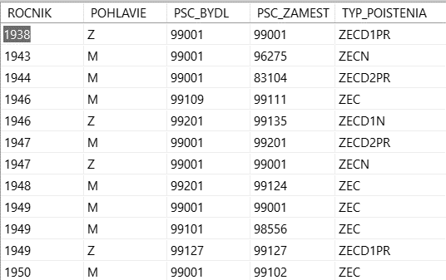
Data
For the analysis, we have an extensive database from the Slovak Social Insurance Company covering the years 2012 and 2022 to show the main challenges in demographics and commuting and to provide a basis for decisionmakers to create data-based policy for better urban/rural planning in local governments.
Database for each year contains more than 3 million insurance entries in the following format:

Slide 9
Classification of ZIP codes
Urban (U) - postal codes located within an urban center greater than 50k. There are a total of 11 cities that we can consider to be urban centers.
Bratislava (UBA) - the capital city of Slovakia.
Bratislava commuter zone (UBAc) - this represents the extended urbanized area that makes up the greater Bratislava metropolitan area.
Commuter zone (C) - these are postal codes that are adjacent to an urban center. We classified a commuter zone as a community that was within 10km of an urban center. This was extended to 15km if it was connected to the urban center by a highway.
Micropolitan center (M) - these are the towns with 10-45K people (60 towns in total). These smaller towns are urban centers on a smaller scale..
Rural (R) - postal codes of municipalities with less than 10K in population that are not adjacent to an urban center.

Slide 10
Urban and rural areas in Slovakia
We used MS Power BI to geo-locate the post office address off each of our zip code areas:
UBAc, U and C – red
Micropolitan- dark blue
Rural - light blue

Slide 11
Economic connection to the address of the work headquarters
The % of individuals who live in and have a work connection in the same rural zip code.
The % of individuals who live in and have a work connection in a rural zip code (rural home zip + rural zip).
The % of individuals who live in a rural area and have a work connection to a micropolitan area.
The % of individuals who live in a rural area and have a work connection with an urban center (Urban + commuter zip).
The % of individuals who live in a rural area and have a work connection to Bratislava or its commuter zone.
Taking the country as a whole, 59.97% of people living in rural areas are connected to some type of urban centre. Interestingly, 13.76% of institutional headquarters (government and corporate) are located in or around the capital Bratislava, giving it a high level of primacy. This even includes the two easternmost regions far afield from the capital, Prešov (11.10%) and Košice (12.10%).
Notes:
If a rural area has a greater than 50% economic connection to one of the above urban centers, then rural can be considered an aesthetic condition rather than an economic one (i.e., a rural area becomes a less populated extension of an urban commuter zone). This point of view could alter the perception and definition of what is thought of as rural.

Slide 12
Rural areas where more than a half of the residents also work in a rural area
If we make the assumption that in order to be considered truly rural, over half of the working contracts would need to belong to a rural region, we found 258 of the 970 zip-code regions exceeded the 50% threshold, representing 26.6% of the rural areas mostly in the south and the east.
Geographically and based on the economic connections of the majority of the rural population, truly rural areas are a small part of the country.
UBAc, U and C – red, Micropolitan- dark blue, Rural - light blue

Slide 13
Conlcuding remarks
From this analysis, it can be said that the term rural is open to interpretation.
On average, only 43.13% of rural working contracts are both living and working in rural areas meaning that the majority of working contracts have an urban connection.
As the geographical data suggest, the economic benefits for Slovakia are decidedly in a westward part of the country and this can be seen in the number of rural areas with less than 50% urban working contracts located in the southern and eastern part of the country.
This paper is the first in a series of research that in addition to other things, will include this data from the Social Insurance Company. Future research will incorporate the new Eurostat ‘degree of urbanization’ which uses population grid cells (number of inhabitants per km2) as a determinant for city (code 1), town/suburb (code 2), and rural (code 3).
Further analysis will help to understand the relationship between rural and urban centres. Also, we wish to measure the level of consumption opportunities (including natality opportunities) based on both population density and remoteness.

Slide 14
Thank you for your attention
Assoc. prof. Mária Murray Svidroňová, PhD.
maria.murraysvidronova@umb.sk

