Slide 1

REVENUE BONDS ISSUED BY LOCAL GOVERNMENTS AS A MEANS OF FINANCING ENVIRONMENTAL INVESTMENTS
Jaroslaw Kostrubiec
Maria Curie-Sklodowska University, Poland

Slide 2
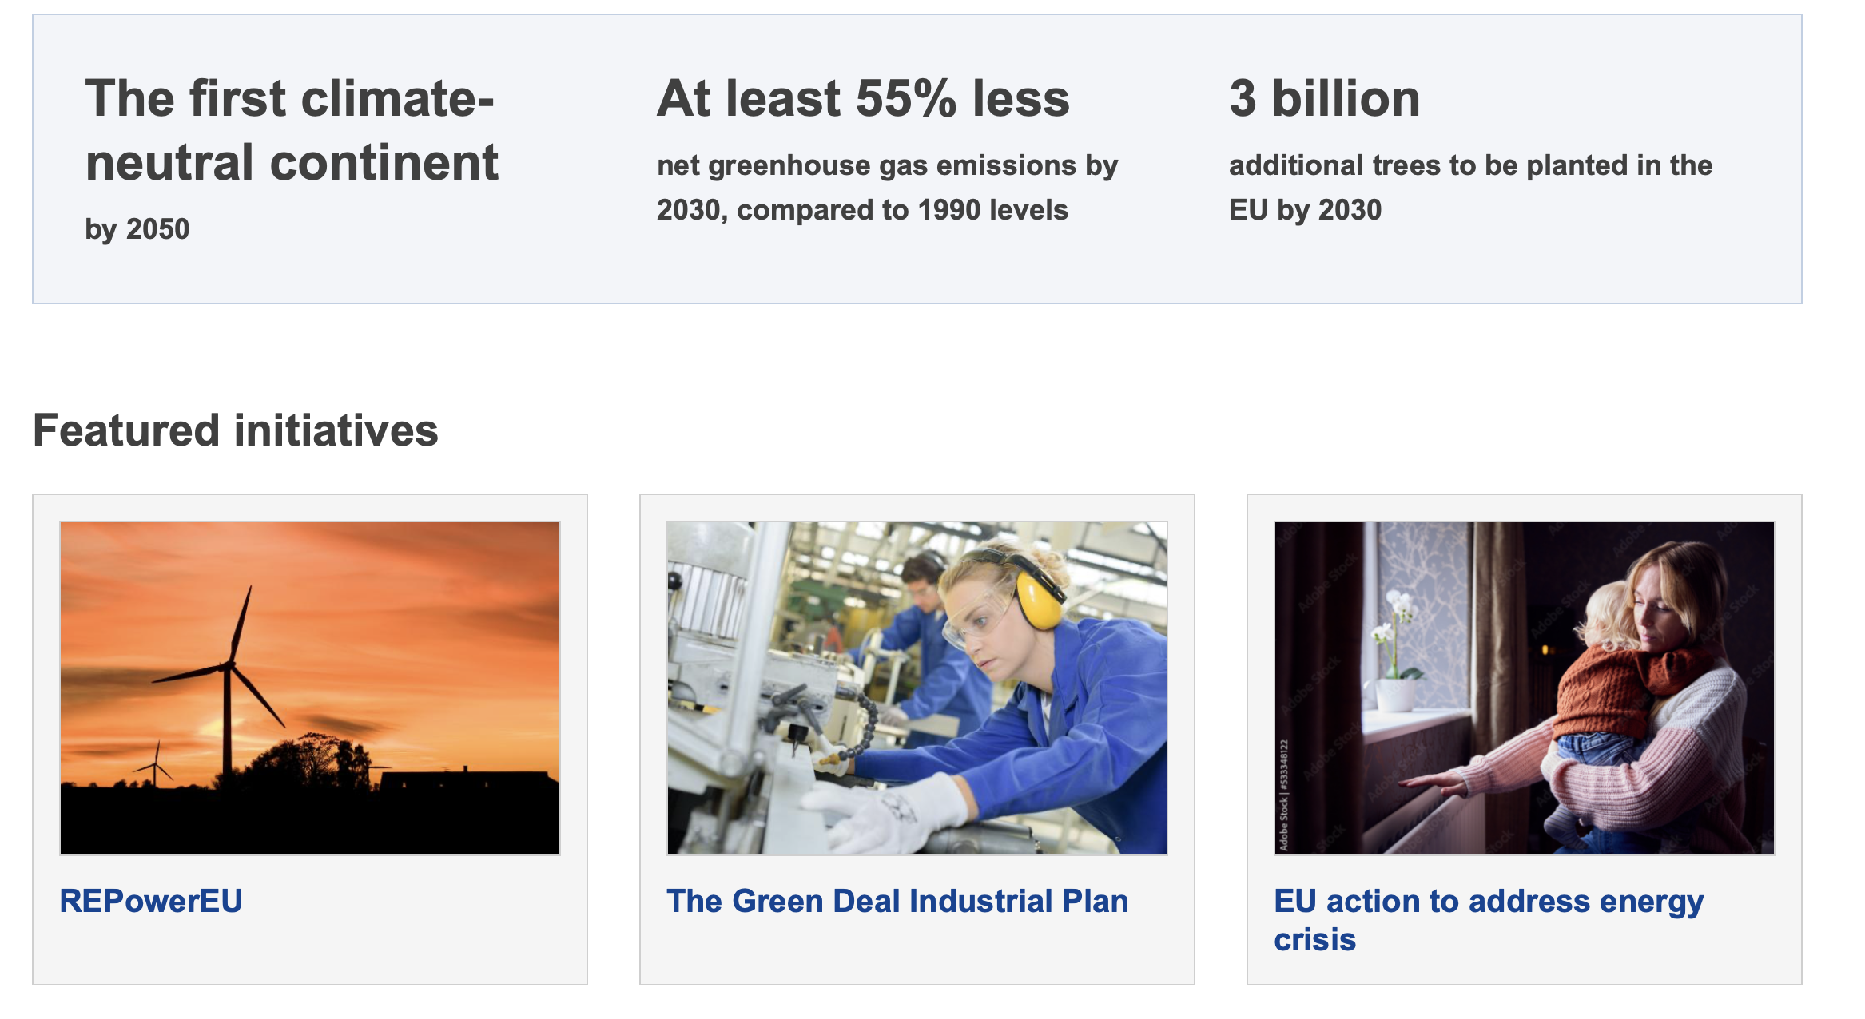


The European Green Deal

Slide 3
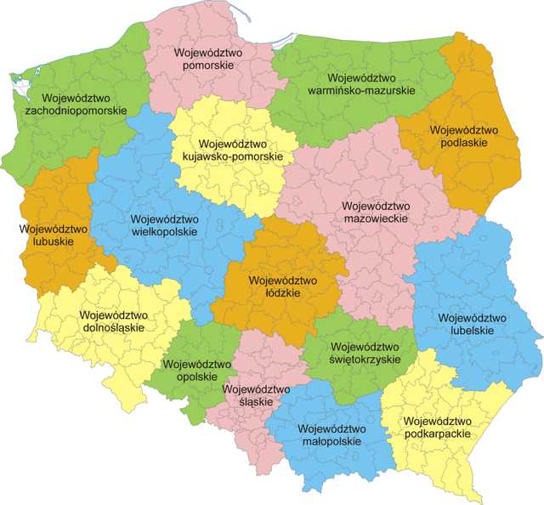

Environmental protection as a task of all local government units in Poland
2477 municipalities
314 districts and 66 cities with district rights
16 regions

Slide 4

Act on Municipal Self-Government
environmental and nature protection and water management
municipal waste water disposal and treatment
maintenance of cleanliness
maintenance of waste disposal sites
disposal of municipal waste
communal greenery and tree planting

Slide 5

Act on district self-government
water management
environmental and nature protection

Slide 6

Act on regional self-government
preservation of the values of the cultural and natural environment taking into account the needs of future generations
rational use of natural resources and the shaping of the environment in accordance with the principle of sustainable development

Slide 7

Revenue bonds issued by local authorities as a means of financing environmental tasks

Slide 8

Advantage No. 1
1) Competence to limit the liability of the issuer (local government)
2) Possibility of the bondholder being granted a right of claim before other creditors of the issuer

Slide 9

Competence to limit the liability of the issuer (local government)
1) limitation of the local government's liability to the amount of revenues
2) limitation of the local government's liability the value of the assets of the project

Slide 10

Possibility of the bondholder being granted a right of claim before other creditors of the issuer
from all or part of the income or from all or part of the property of the projects that were financed with the funds obtained from the issue of the bonds
from all or part of the income of other projects specified by the issuer (local government unit)

Slide 11

Advantage No. 2
The income from revenue bonds does not negatively affect the individual debt ratio of local governments

Slide 12
Statistics
REVENUE BONDS issued by local governments
up to PLN 600 (EUR 140) million for 24 years - Municipal Water Supply and Sewerage in Bydgoszcz (limited liability company)
up to PLN 166 (EUR 38) milion - Municipal Transport Company (Miejskie Przedsiębiorstwo Komunikacyjne) in Łódź Sp. z o.o. (limited liability company)
up to PLN 60 (EUR 14) million - Zakład Komunikacji Miejskiej (Public Transport Company) in Gdańsk Sp. z o.o.
Up to PLN 28 (EUR 6.5) million - Przedsiębiorstwo Wodociągów i Kanalizacji in Gniezno (Municipal Water Supply and Sewerage)
up to PLN 145 (EUR 34) million - Tramway Fordon (limited liability company), based in Bydgoszcz
up to the amount of PLN 40 (EUR 9.3) million - City of Lublin
up to the amount of PLN 21 (EUR 4.8) million - Nysa Municipality

Slide 13
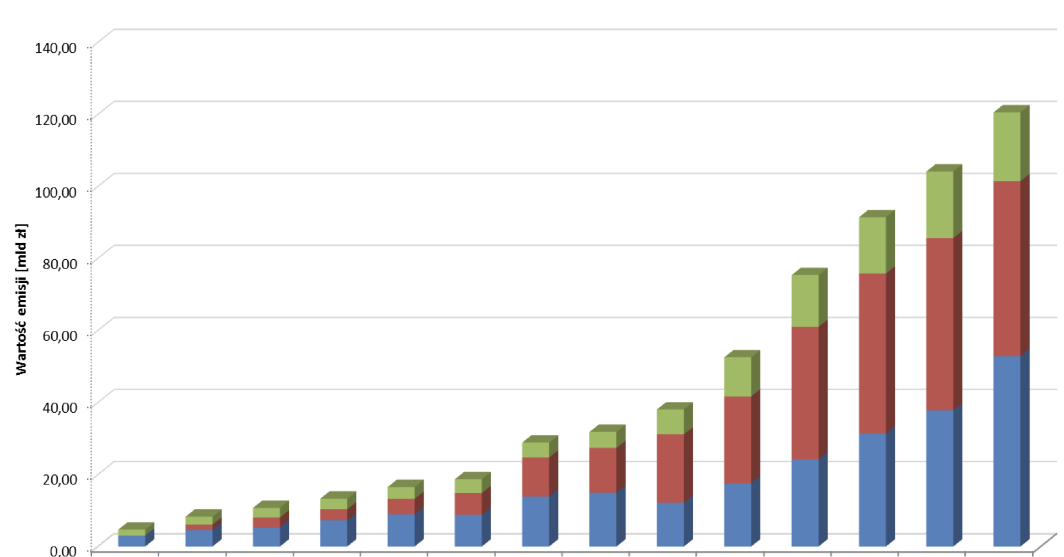
Growth in long-term bond issuance in Poland
Municipal bonds
Bank bonds
Company bonds

Slide 14
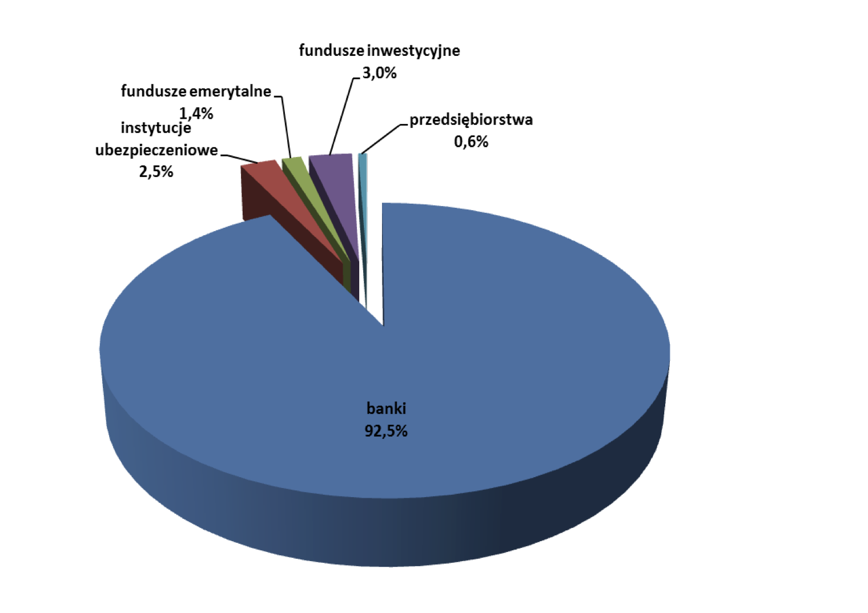
The structure of purchasers of the REVENUE BONDS
banks 92,5 %
investment funds 3%
Insurance institutions 2,5%
pension funds 1.4%
companies 0.6%

Slide 15

1
Conclusions
Do not burden the budget of the local government - exclusion of benefits to bondholders (interest payments, redemption of bonds, commissions)
Relatively simple procedure for preparing a revenue bond issue - compared to a loan application
Low cost of raising the capital

Slide 16


