Slide 1
The transformation of the financial autonomy of local self-governments
Dr. habil. András Bencsik PhD
associate professor
Eötvös Lóránd University, Faculty of Law, Department of Administrative Law
18th March 2024
Notes:
Dear Professors, Dear Colleagues!
First of all, I would like to thank you for the opportunity to speak at this international scientific conference. The subject - local government finance - is a topic that is always topical in our region. I would also like to say in advance that I will make a special effort to keep within the time limits, because anyone who talks a lot - as the last speaker at the conference - is capable of other evil things ☺

Slide 2
Topics of the presentation
Theoretical background
The creation of Act LXV of 1990
Modification of the former regulation
Reduction of autonomy
Notes:
In my presentation, I will present the legislative measures in Hungary in recent years, which, in my opinion, have limited the financial autonomy of local governments, after mentioning basically 3 preparatory aspects.
In this context
I will briefly refer to the theoretical background on the importance of financial autonomy and its role in ensuring local government autonomy,
I compare the basic framework of local government regulation as it was established in 1990 and changed in 2012,
I will then discuss some of the steps taken to narrow the financial space.

Slide 3
1. Theoretical background
Interpretations of local self-government
Organisational principle
Operating mechanism
Procedural technique
Municipiality – local government – local self-government
Local self government – autonomy
organisational
operations
administrative
financial
Notes:
In the framework of the theoretical foundations, it is worth starting with the fact that the interpretation of self-governance can be carried out at least on three levels, since the relevant literature considers it as an organisational principle, a functioning mechanism and a procedural technique. Without going into detail, I would point out that these three levels can be easily identified with the organisational, operational, administrative and financial autonomy of local authorities as components of autonomy.

Slide 4
2. Creation of Act LXV of 1990
Political changes of 1989/1990
Real decentralisation
Strong basic level of local government
Wide responsibility
Legality control
obligatory tasks
indebtedness
lack of resources
Notes:
The political changes of 1990 saw the establishment of a system of local self-government, replacing the previous hierarchical local-regional administration, and realized a real decentralisation by the legislator of the time. The basic feature of the system was that the two-tier system of local government was not focused on the territorial level but on the municipal level, giving local authorities wide responsibility and comprehensive powers, while the state exercised only powers of control over the legality of local government. The story goes on: as the number of compulsory tasks continued to grow and financial resources became scarcer, the problem of indebtedness of local authorities emerged, which led to a reduction in financial autonomy as one of the main elements in the changes to local government regulation.

Slide 5
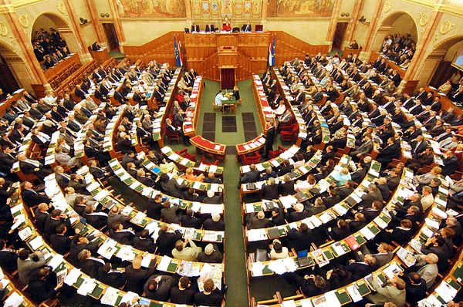
3. Modification of the former regulation (Act CLXXXIX of 2011)
Reform of the local self-government system
Cost-effectiveness
Strong basic level of state administration
Centralisation of public services
Legality supervision
Notes:
In 2011, the legislator passed the Local Government Act, which is still in force today, and which fundamentally redesigned the local government system. The main changes are summarised below:
the starting point for financial autonomy has been cost-effectiveness, which in many respects has limited the municipalities' freedom of management,
municipalities were replaced by local and regional administrations (government offices and district offices), which also affected the responsibilities of local authorities,
there was a strong centralisation of certain public human services, so that several former municipal competences (e.g. education, primary health care, certain social services) were made state functions, which also affected funding,
State control over local government has also been strengthened, with the newly created government agencies now exercising supervisory powers over the rule of law.

Slide 6
4/1. The establishment of district offices
Reform of the territorial public administration
External integration (2011): C and M government offices
Strong basic level of public administration: district offices
Internal integration (2015)
Strengthening of district offices
Migration of competences (LSG → DO)
Entry into force of procedural codes (DO → GO)
Notes:
Under the new system, the first important step in terms of municipal autonomy was the establishment of district and county government offices. The process basically consisted of 3 steps: first, the creation of county and capital government offices, which involved a reduction of the number of deconcentrated state administration bodies by almost half. This was followed by the creation of the district and district offices, which soon became the main actors of territorial administration, and then by an internal integration within the government office, which was a significant step in terms of the exercise of competences and the relativisation of professional autonomy. The emergence of the district offices was decisive in two dimensions: on the one hand, the disappearance of certain municipal powers and, on the other, the reduction of the scope for legal redress, due to the extension of the powers of the regional government office. In this context, it is worth noting that in Slovakia, around the turn of the millennium, the opposite legislative action was taken, with the legislator transferring more state administrative powers to the municipal sector.

Slide 7
4/2. The system of task financing
The OGY shall grant aid for the statutory tasks to be performed in accordance with the public service level laid down by law
Principles
Thrifty management
Expected own income
Actual own income
Only for MANDATORY tasks
may be given for an OPTIONAL task
Notes:
The introduction of the system of task funding, under which Parliament provides support for the performance of compulsory local government tasks, has had a major impact on the financial margin due to the reduction in tasks. I would like to highlight the following anomalies in this regulation:
fewer local government tasks result in a systemically lower value of the normative grant,
only in the case of compulsory tasks is the Parliament obliged to comply with this obligation, and in the case of optional and alternative tasks it is only a possibility,
It may be seen that the principles of funding also include subjective categories, which do not necessarily result in predictable funding.

Slide 8
4/3. „Change of profile" for territorial local self-governments
INSTITUTIONAL MAINTENANCE
REGIONAL DEVELOPMENT
mergers of municipalities
weak territorial level
fragmented settlement system
strong territorial level
Notes:
The next stage was the transformation of territorial self-government. In an international comparison, a distinction can be drawn between two models: the Scandinavian model, which has a less fragmented level of local government and a weaker territorial level, and the french model, which has a rather fragmented level of local government and a strong territorial level. The Hungarian mixed system, with its rather fragmented municipal level and the limited powers of county governments, can be considered a „hungarikum”. To summarise the essence of the change: the former functions of maintaining institutions are now replaced by development functions.

Slide 9
4/4. Restrictions on borrowing
Regulation of the Basic Law of Hungary
The law may make the borrowing or other commitment of a local government, to the extent provided by law, subject to conditions or to the consent of the Government in order to preserve the budgetary balance
Act CXCIV of 2011 (stability act)
As a rule, a debt-creating transaction can only be concluded with the consent of the Government
The local government must inform the Government in advance of its intention to borrow
Notes:
A new legal institution affecting financial autonomy was also introduced into Hungarian legislation when the legislator restricted the borrowing activities of local governments due to their indebtedness. Under the authority of the Fundamental Law, a law on economic stability was passed in 2011, which, as a general rule, makes the conclusion of debt-generating transactions by local governments subject to the prior consent of the Government. It should be pointed out that this power is exercised by the Government through the government agencies and that it is considered to be a government act without legal remedy, which highlights the relative loss of economic autonomy.

Slide 10
5. Conclusions
fewer local government responsibilities
less state support
less own income
development without money?
strong state supervision
Notes:
As a brief conclusion to the presentation, I would like to draw some conclusions:
the role of local governments in the Hungarian public administration is in continuous decline,
The local authorities in Hungary are showing a significant decline in local government in Hungary, resulting in a steady decline in state support,
The role of local governments is continuously decreasing, which leads to a continuous decline in the role of local governments in the state budget,
but state control is increasing.
To conclude, I would like to use the classic line from the Chernobyl series: the situation is not tragic, but it is not good!

Slide 11
Thank you very much for your attention!

