Slide 1
Financial Sustainability of Local Governments
18-19. March 2024
University of Győr
Challenges of the current tax-sharing system in Slovakia
Anna Vartašová – Miroslav Štrkolec

Slide 2
Research background
LG funding:
  complex system, dominance of state-transferred funds
  tax sources:
    Municipalities: local taxes & state-shared taxes
    HTU: state-shared taxes (NO local taxes)
state-shared taxes = PIT (100%) only!
research question = is system with just 1 shared tax OK?:
  ? sufficiency
  ? stability & foreseeability

Slide 3
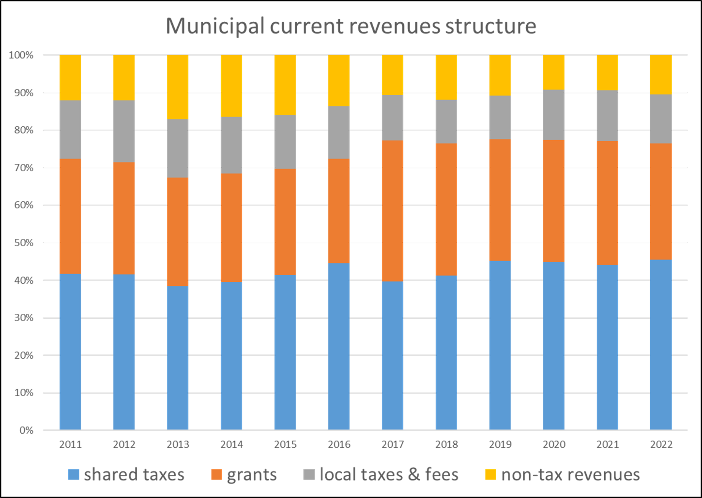
Sufficiency of current shared-tax system?
Previous research shows high dependence of municipalities on state-transferred funds (cca 70%)
  HTU (no local tax) – even more
In 2020 (Covid) – ad hoc funds suplementing the gap in PIT monthly income transfers
In 2023&2024 – additional shared part of CIT
Answer: NO

Slide 4
stability & foreseeability?
Stability:
  year-on-year change in the nominal annual income (2005-2022)
  monthly income regularity (2018-2022)
Foreseeability:
  ratio between the budgeted and actual income (2005-2022)
--------
  PIT – compared to CIT, VAT & excise duties

Slide 5
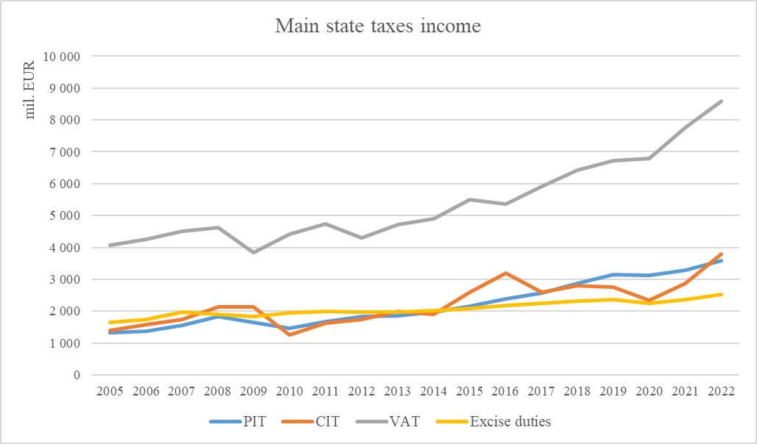
Overal situation

Slide 6
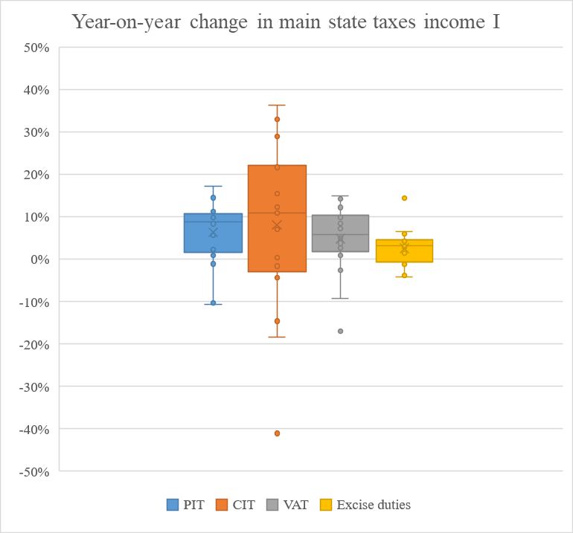
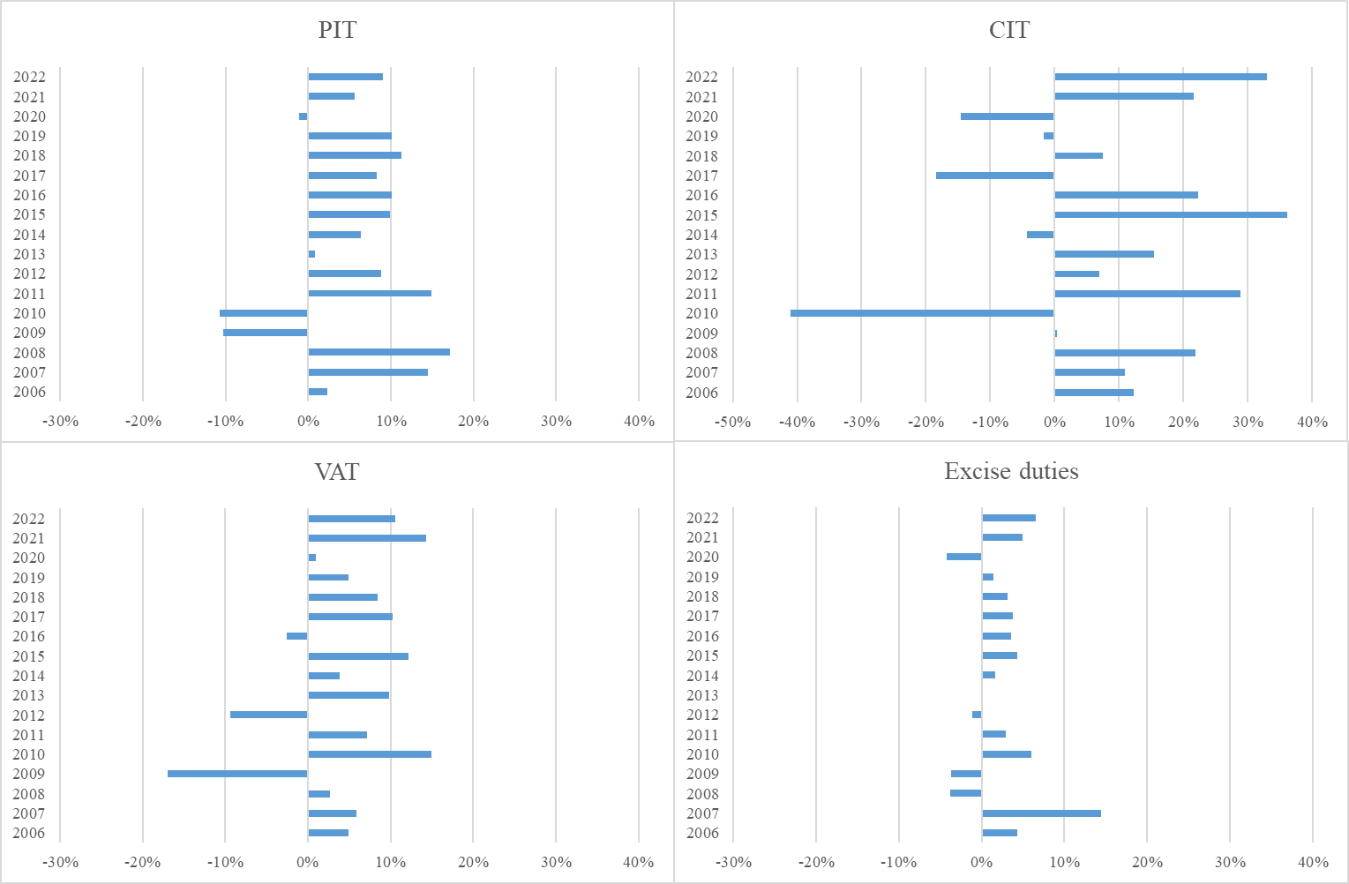

Slide 7
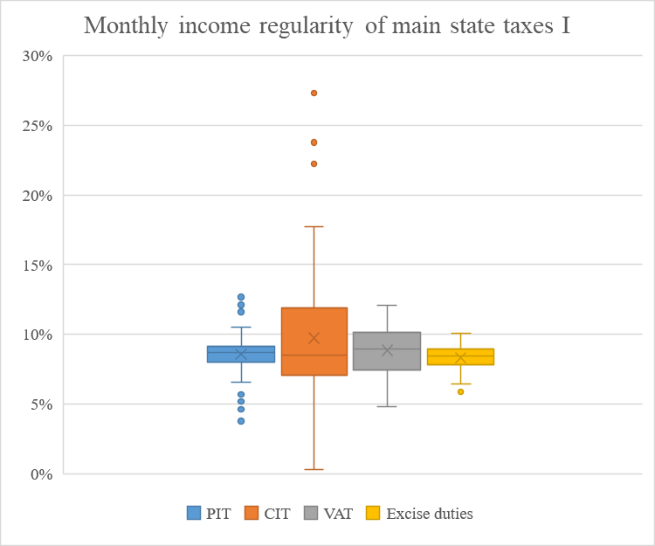
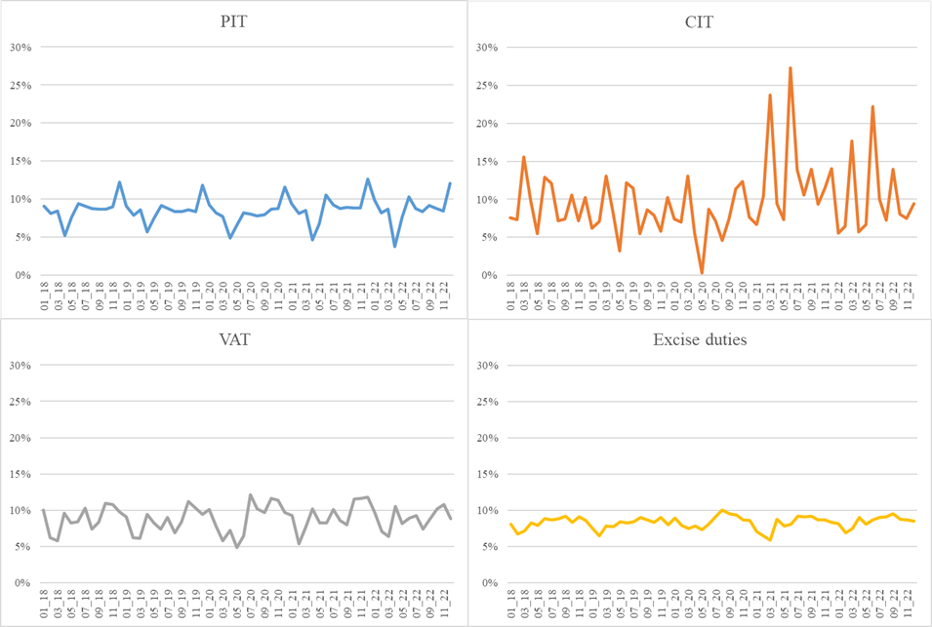

Slide 8
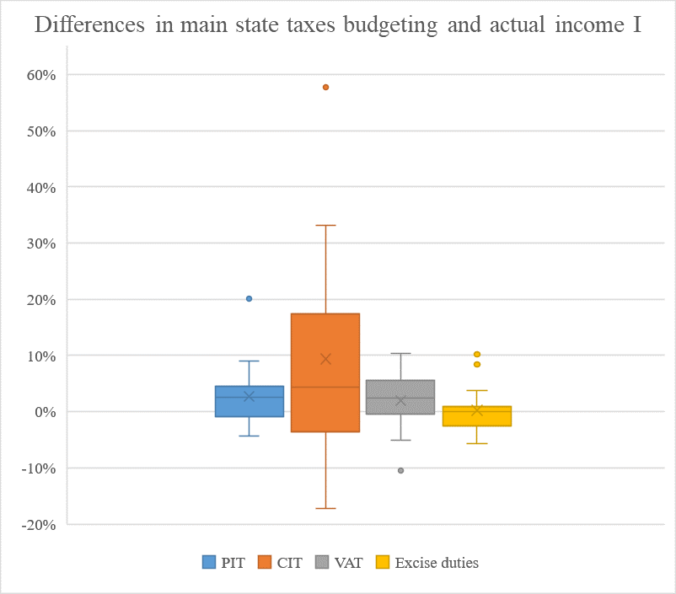
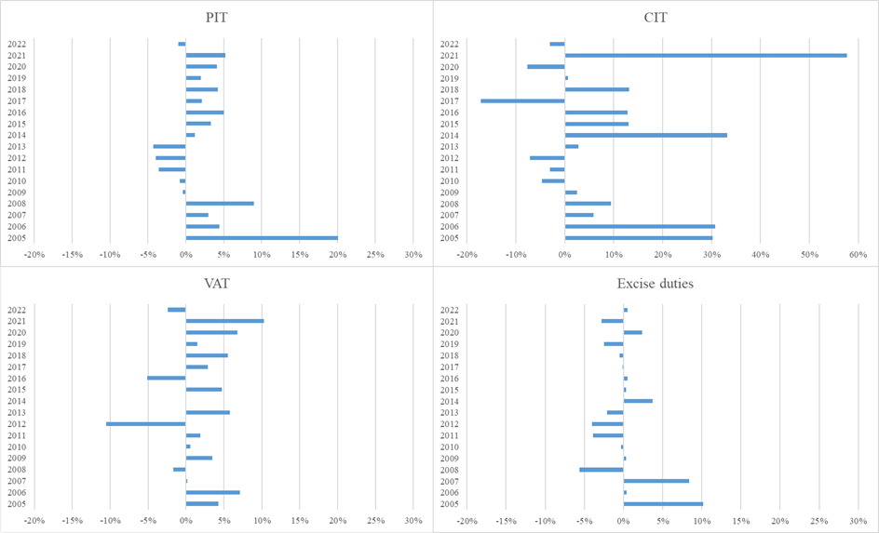

Slide 9
Partial conclusions – stability & foreseeability
Best: excise duties (but lowest yields) = stability does not mean best profitability
Worst: CIT (but if any, then higher than expected)
VAT: overal stability (monthly cyclical), predictable (+high yields)
PIT: still enough stable and predictable (still good yields)

Slide 10
Our neighbours´ solutions
CZ: sharing VAT, PIT (part) and CIT
PL: sharing PIT and CIT
AT: sharing almost all of the taxes
HU: extreme - small part of PIT – cca 1% of LG´s reveneues, but LT = cca 30%, state grants = cca 50% (2019)
Future SK: almost 1/3 of political parties speaks for broadening of tax mix

Slide 11
To conclude
most of neighbouring states do not rely on 1 shared tax only
each tax has its positives and negatives - difference between profitability and stability - in SVK the most stable tax is yielding the least
suggested enlargement of state-shared taxes mix to overcome the peculiarities in development of particular taxes income
  from stability point of view – best VAT, PIT & Excise
In times of crisis, most taxes, if not all of them, dropped, however, not all of them in the same extent!
To evaluate only PIT as a shared tax – good choice (there are worse stabile and/or profitable taxes)

